Slide 1

Hackathon 2024
Cognicrafters

Slide 2
Interview validation Assistant

Slide 3

Problem Statement
Challenges in Manual Interview Process
Time-Consuming Screening: Manual screening of resumes and applications can be time-consuming, leading to delays in shortlisting candidates.
Bias and Inconsistency: Human bias and inconsistency in candidate evaluation can affect the fairness of the selection process.
Data Management: Keeping track of candidate data, interview schedules, and feedback can be overwhelming without a digital system.
Communication Hurdles: Coordinating interviews, sending reminders, and sharing feedback among the interview panel can lead to communication gaps.
Limited Insights: Lack of data analytics and reporting tools makes it challenging to derive insights for process improvement and decision-making. These problems highlight the inefficiencies and challenges of manual interview processes and set the stage for introducing the benefits of an Interview Management System.

Slide 4
Introduction
Digital Recruitment Revolution: Introducing our comprehensive Interview Management System, a digital solution designed to transform and automate recruitment processes.
Centralized Dashboard: At its core, our system provides a robust homepage acting as a centralized dashboard, offering real-time insights into the interview pipeline.
Effortless Data Entry: HR professionals can seamlessly add job requirements and candidate information, streamlining the process.
Resume Validation: The system employs Language Learning Models (LLMs) to validate resumes and offer valuable recommendations.
Tailored Interview Questions: Enhance interview preparation with auto-generated questions tailored to candidate profiles and job specifications.
Efficient Scheduling: Integrated interview scheduling and post-interview functionalities simplify logistics and data management.
Informed Decision-Making: Post-interview analysis synthesizes discussions into actionable reports, empowering HR departments with data-driven insights.

Slide 5












Technology Stack
User
Frontend
Backend
AI/ML
Database
Browser
React
Python
OpenAI
Mongodb
JavaScript
Fastapi
Gemini AI
HTML
Meta Llama 2
CSS
Bootstrap
©2024 KANINI Software Solutions. Confidential

Slide 6
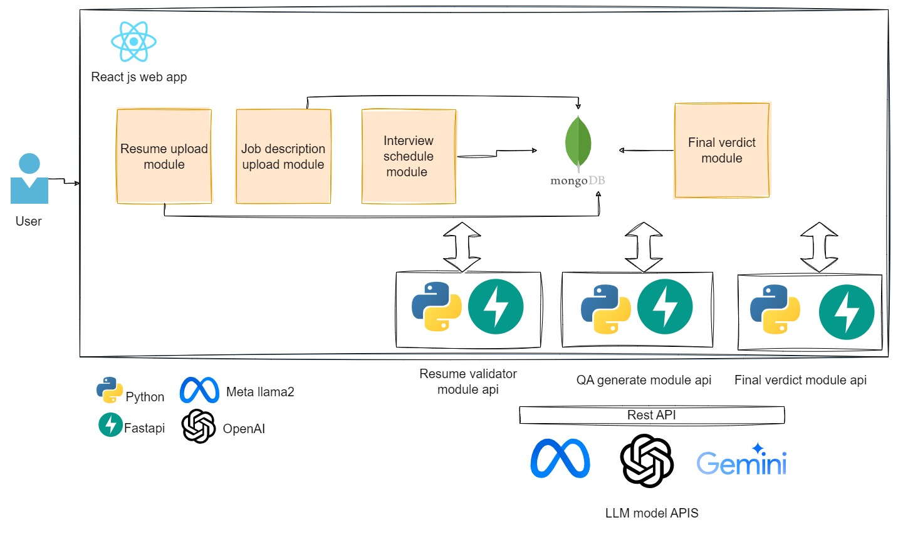
Conceptual System Diagram

Slide 7
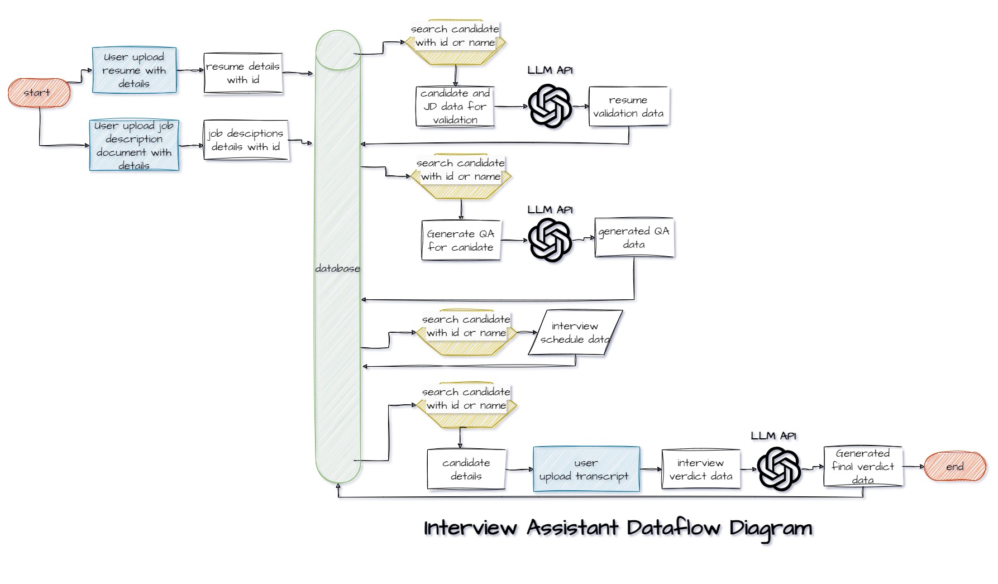
Data Management: Physical Data Flow

Slide 8
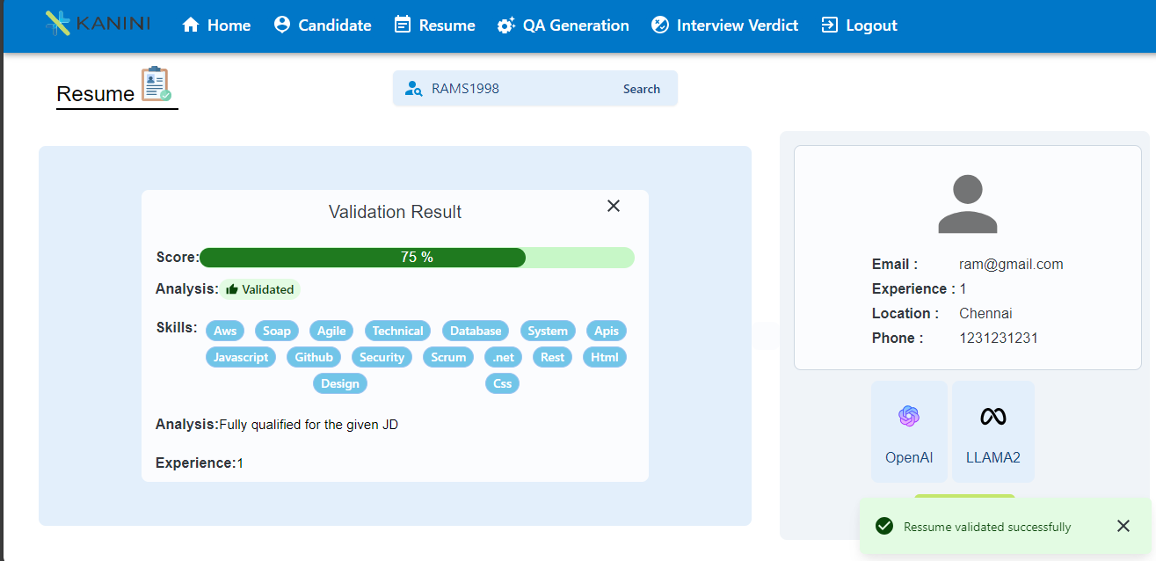
Resume Validation Process Module

Slide 9
Resume Validation Workflow
Upload Resume and Job Description​:
Users upload candidate resumes and provide job descriptions.​
Data Extraction and Storage:
​System extracts candidate details from resumes.​
Candidate info and job description stored in MongoDB.​
Search for Candidate :
​Users search for candidates using candidate IDs.​
Resume Validation Module​:
Initiate Generative AI -based resume validation module.​
Validation Outcomes​:
Module provides outcomes: Accept, Reject, or Consider.​Outcomes explained based on skills and qualifications

Slide 10
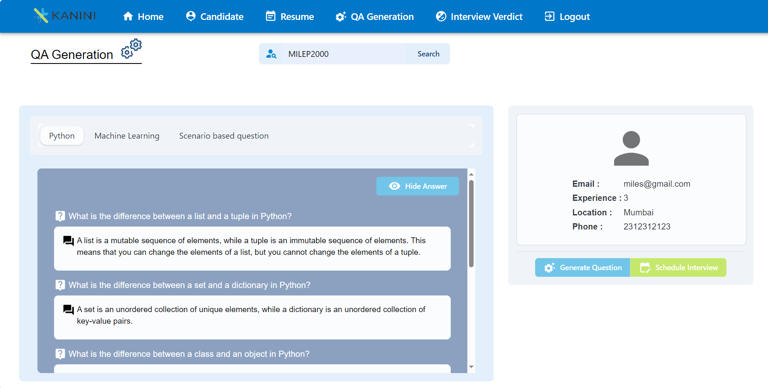
QA Generation Module

Slide 11
QA Generation Module
1.Candidate Search
Search for candidates based on specific criteria.
Retrieve candidate information, including resume details.
2.Skill-Based QA Generation
Utilize Generative AI Language Learning Models (LLMs).
Generate lists of interview questions tailored to different skill sets.
3.PDF Document Generation
Compile generated questions into a downloadable PDF document.
Ensure easy access and sharing of interview questions.
4.Customized Interview Preparation
Empower interviewers with skill-specific questions.
Enhance candidate assessments for various roles.
5.Efficiency and Accuracy
Streamline the interview preparation process.
Improve interview quality and candidate evaluations.

Slide 12
Interview Schedule Module
1.Candidate Search
Search for candidates using their unique candidate ID.
Retrieve candidate details for interview scheduling.
2.Interview Scheduling
Schedule interviews with date and time preferences.
Set up virtual meetings on platforms like Zoom or Teams.
3.Link Generation
Automatically generate meeting links for scheduled interviews.
Ensure easy access for both interviewers and candidates.
4.Data Storage and Dashboard Update
Store interview details and meeting links in the database.
Update the dashboard status for the specific candidate to "Interview Scheduled."
5.Streamlined Process
Simplify the interview scheduling process.
Enhance candidate tracking and communication.

Slide 13
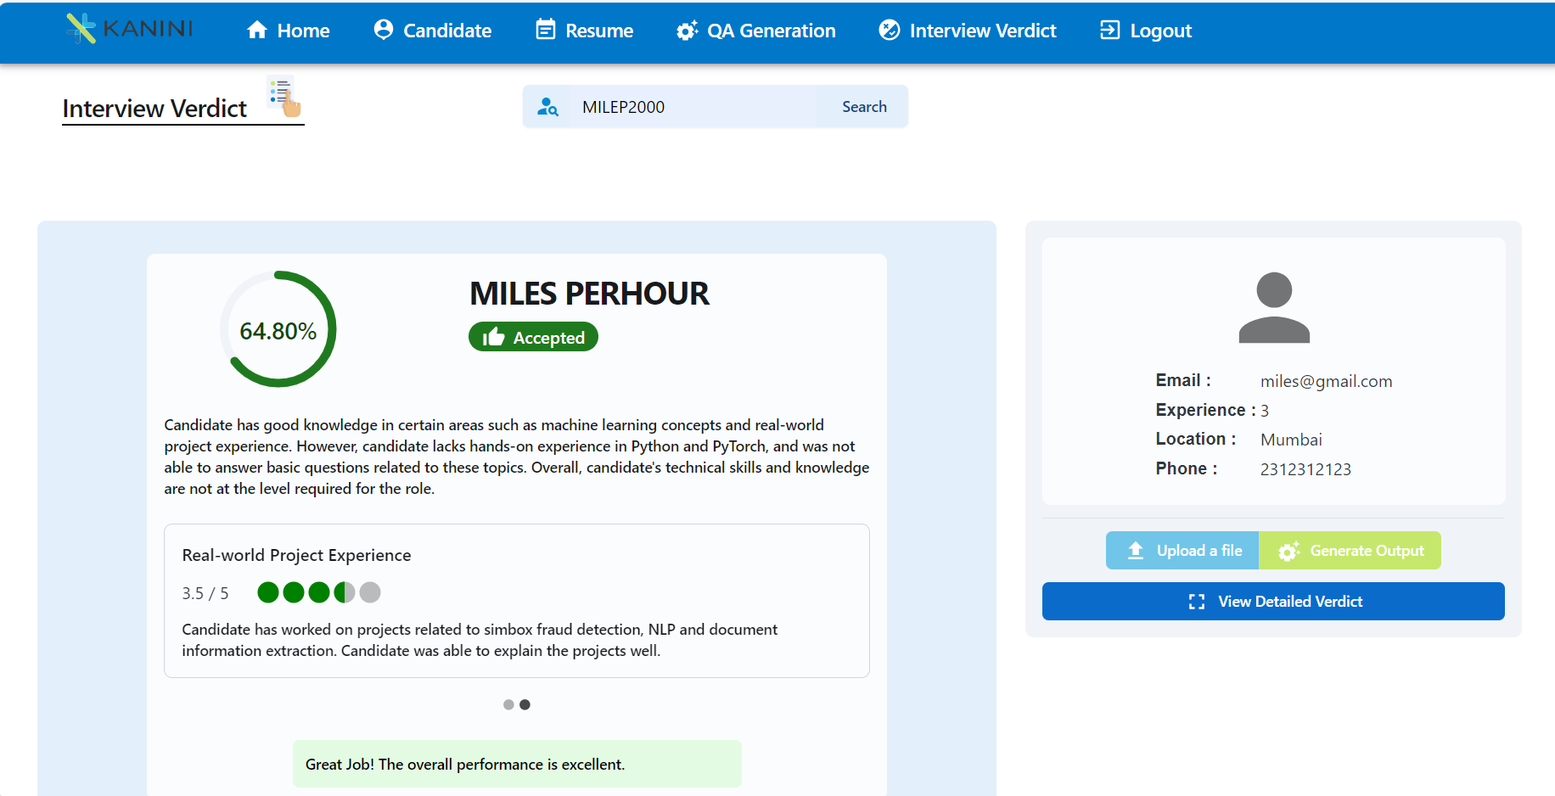
Final Verdict Module

Slide 14
Final Verdict Module
1.Candidate Search
Search for a specific candidate using their unique candidate ID.
Retrieve candidate details from the database.
2.Upload Interview Transcript
Upload the interview discussion transcript file for analysis.
Prepare for the final verdict assessment.
3.Generative AI LLM Analysis
Utilize Generative AI Language Learning Models (LLMs).
Generate the final verdict, including:
Final Score
Topic Scores with Explanations
Question Scores with Explanations
4.Display and Storage
Display the final verdict results in the user interface.
Store the results in the database for future reference.
5.PDF Document Generation
Generate a downloadable PDF document of the final verdict.
Enable easy sharing and record-keeping.
6.Dashboard Update
Modify the final verdict status on the dashboard for the respective candidate to reflect the assessment.
7.Efficient Evaluation
Streamline the final verdict process with AI-driven analysis.
Enhance candidate assessment and decision-making.

Slide 15
Core Features and Benefits
Centralized Dashboard: Efficiently manage the interview pipeline.
Resume Validation with LLMs: Utilize gen AI LLM models for resume validation.
Tailored Interview Questions: Generate customized interview Q&A using gen AI LLM.
Seamless Interview Scheduling: Streamline logistics with integrated scheduling.
Post-Interview Analysis: Automatically synthesize discussions into reports using gen AI LLM.
Responsive Data Management: MongoDB ensures efficient data storage.
Enhanced Efficiency: Optimize HR processes for better decision-making.

Slide 16
Future Enhancements
1.Advanced Resume Analysis
Utilize Vector Databases for complex resume-job description analysis.
2.Enhanced EDA Visualization
Expand EDA capabilities, including candidate location mapping.
Visualize complex data plots for deeper insights.
3.Automated Interview Scheduling
Implement automatic interview scheduling.
Send notifications and reminders via email and WhatsApp for efficient coordination.
4.Customized Interview Questions
Generate complex interview questions based on candidate resumes.
Tailor questions to the interview level, enhancing assessment accuracy.
5.Chatbot-Driven Interviews
Integrate chatbots for interactive and automated interviews.
Enhance candidate engagement and streamline the interview process.
6.LinkedIn Resume Selection Automation
Automate the selection of resumes from bulk sources like LinkedIn.
Efficiently filter and manage a large pool of candidates.
7.Predictive Candidate Performance
Develop predictive models to assess candidate performance before interviews.
Improve decision-making and candidate selection accuracy.

Slide 17
Thank you

